Slide 1
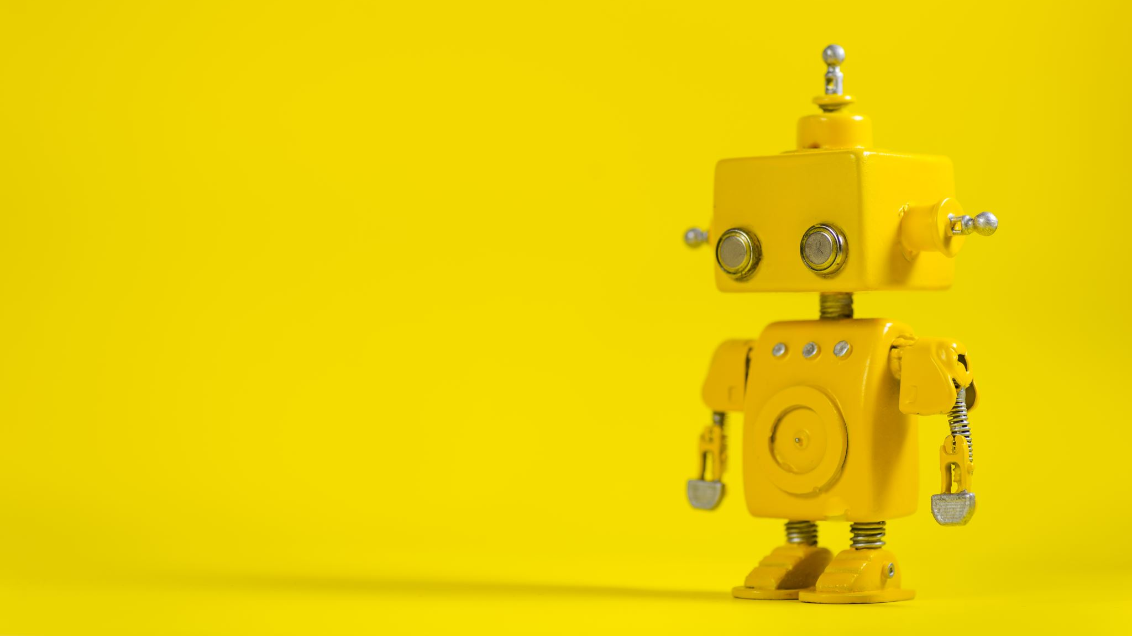
Artificial MD
A machine LEARNING Approach diagnosing heart disease and diabetes

Slide 2
Project objectives
Study into Machine Learning in Medicine
Build a Management System Software
Predicting Heart Disease and Diabetes

Slide 3
Why use machine learning in medicine?
Increased Popularity of Machine Learning and Data Science
Medicine is Very Data Driven
Improve the Workflow of a Physician

Slide 4
Risks of machine learning
Difficult to Obtain Data
Limited Datasets
Imbalanced Datasets
Practicality of Machine Learning in Medicine
Constantly Evolving Field

Slide 5
Obtaining Data
Heart Disease
Diabetes

Slide 6
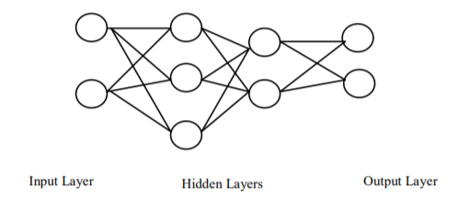
Handling Limited Datasets
Shaikhina, et al. (2017) Used Neural Networks [1]
Multiple Runs
Comparing Thousands of Neural Networks

Slide 7
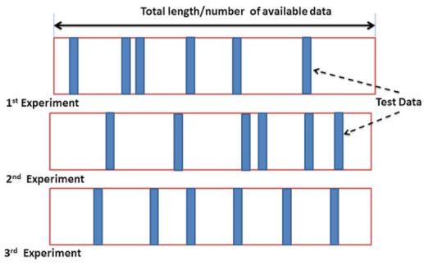
Handling Imbalanced datasets
Random Sub-sampling [2]

Slide 8
Practicality of Machine learning in medicine
Overreliance Leads to Deskilling. [3]
Is it Useful?

Slide 9
Management system
Improve the Workflow of a Practice
Caters to Management Processes
Multiple Pages
Stores Important Information

Slide 10
REFERENCES
[1] Shaikhina T., & Khovanova N. A. (2017). “Handling Limited Datasets with Neural Networks in Medical Applications: A Small-Data Approach”. Artificial Intelligence in Medicine, 75, pp. 51-63. https://doi.org/10.1016/j.artmed.2016.12.003
[2] Mathew J., & Remesan, R. (2014) Hydrological Data Driven Modelling: A Case Study Approach, Berlin, Germany: Springer.
[3] Hoff, T. (2011) “Deskilling and Adaptation Among Primary Care Physicians Using Two Work Innovations”, Health Care Manage Review, 36(4), pp. 338-48.
Video Demonstration: https://youtu.be/SKYj_Pq9TfU

